Slide 1

Public Hearing
2025 Integrated Resource Plan
  Today (12/1):
    Public Hearing per RCW 19.280.050
    Public comments received to date
    Public comment period ends 12/8
    Additional comments/questions from the Board
  Next steps (12/15):
    Board considers resolution

Slide 2
Public Hearing
2025 Clean Energy Implementation Plan
  Today (12/1):
    Public Hearing per RCW 19.405.060
    Public comments received to date
    Comment period ends 12/8
    Additional comments/questions from the Board
  Next steps (12/15):
    Board considers resolution

Slide 3
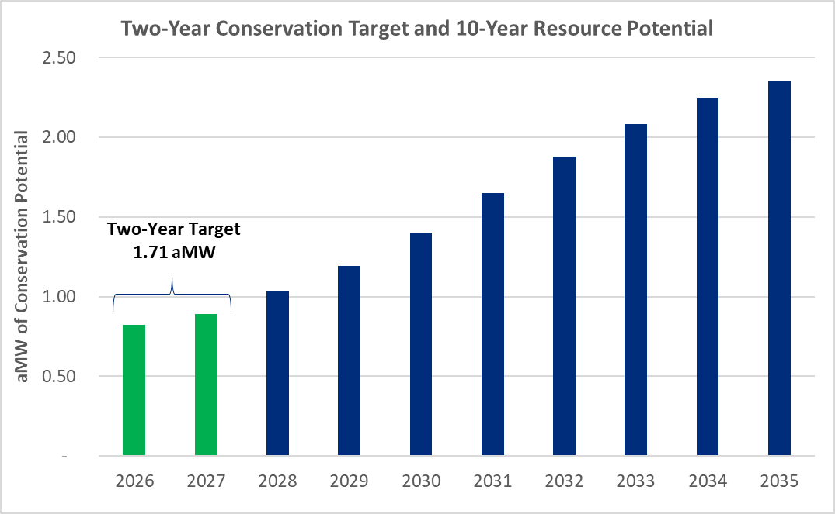

Slide 4
Public Hearing
2025
Ten-Year Conservation Resource Potential &
Biennial Conservation Target
  Today (12/1):
    Public Hearing per WAC 194-37-070,(3)(d)
    Public comments received to date
    Comment period ends 12/8
    Additional comments/questions from the Board
  Next steps (12/15):
    Board considers resolution

