Slide 1

2025 Integrated Resource Plan
Finalized Portfolio Analysis & Draft IRP Document
November 17, 2025
Becky Keating
Senior Energy Analyst

Slide 2
Why We’re Here Today
  Purpose:
  To review the DRAFT Integrated Resource Plan (IRP) and discuss next steps for compliance with RCW 19.280: Electric Utility Resource Plans.
Key Compliance Milestones:
  December 1, 2025: Public hearing on Final draft IRP
  December 15, 2025: Resolution presented for Board Approval
  September 1, 2026: Submit IRP to the Department of Commerce by
  No Board action required today

Slide 3
Today’s Presentation
  1. Updated native load forecasts
  2. Summary of recommendations
  3. The Clean Energy Action Plan (CEAP)
  4. Remaining Board and public process schedule

Slide 5
Summary of Recommendations
  Resource Mix
  Retain Chelan PUD’s current mix of generating resources for 2025-2034
  Conservation and Demand Management
  Continue to evaluate and implement conservation and demand response programs based on 2025 Conservation Potential Assessment and 2025 Demand Response Potential Assessment
  Portfolio Diversification
  Evaluate new sources of generation for diversification and/or overall portfolio objectives
  Financial Strategy and Risk Management
  Keep evaluating/implementing strategies consistent with financial policies and hedging strategy

Slide 6
Clean Energy Action Plan (CEAP)
  10-Year plan (2025-2034) for implementing sections 3, 4 and 5 of Clean Energy Transformation Act (CETA)
    2025-2029: Maintain Renewable and Efficient Operations
    Currently meeting no coal standard.
    Retain existing hydro and wind mix of renewable generating resources.
    Continue to pursue conservation and demand response.
    2030-2044: Greenhouse Gas (GHG) Neutral Standard
    Up to 20% of retail load may be served with alternative compliance options, such as renewable energy credits (RECs).
    Large Loads are contractually responsible for meeting applicable CETA requirements.
    2045: 100% Clean Energy Standard
    Non-emitting resources serving all load standard starts.
    Load growth and diversification goals may prompt more resource needs.

Slide 7
Next Steps
October 20 No board action requested today
  Initial portfolio analysis results
October 20 – December 8
  Public Comment Period
November 17 No board action requested today
  Finalized portfolio analysis and final draft IRP document
December 1
  Public hearing on Final draft IRP
December 15
Resolution presented for Board Approval
Prior to September 1, 2026
Submit final IRP to Department of Commerce

Slide 8
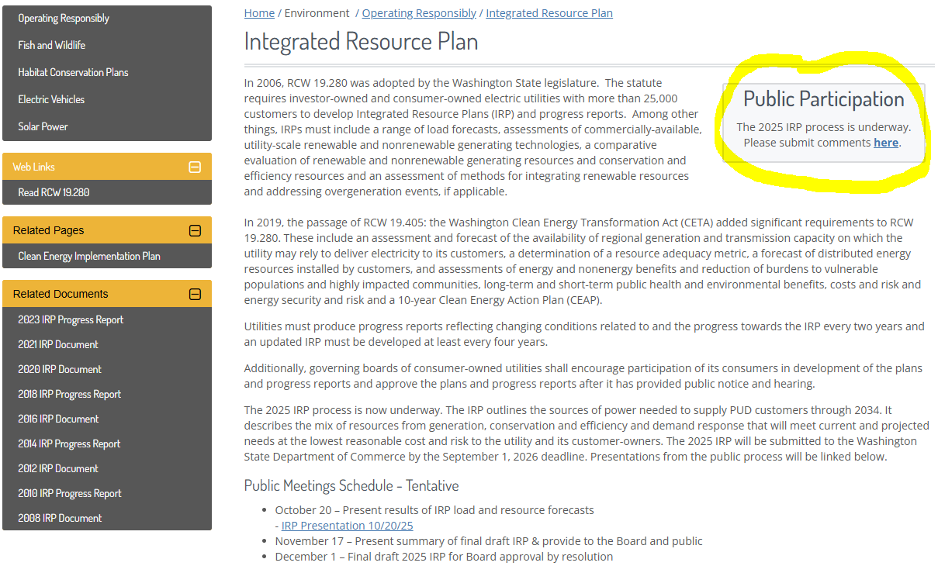
Chelan PUD IRP Website
http://www.chelanpud.org/irp

Slide 9
Questions?

