Slide 1

2025
Integrated Resource Plan
Initial Portfolio Analysis Results
October 20, 2025
Becky Keating
Senior Energy Analyst

Slide 2
Why We Are Here
  RCW 19.280: Electric Utility Resource Plans
  Board Policy Strategic Directive-09
  Integrated Resource Planning (IRP)
  Load forecast
  District net position and load forecasts
  Portfolio: scenario results

Slide 3
Proposed timeline for
Board and Public IRP Process
October 20 No board action requested today
  Initial portfolio analysis results
October 20 – November 24
Public Comment Period
November 17
  Finalized portfolio analysis and final draft IRP document
December 1
  Final draft IRP for Board approval
(Resolution to be presented at public hearing)
Prior to September 1, 2026
Submit final IRP to Department of Commerce

Slide 4
RCW 19.280: Electric Utility Resource Plans
Analysis describing the mix of generating resources and demand-side resources that will meet current and projected needs at the lowest reasonable cost to the utility and its ratepayers
The legislation intends for IRPs to assist in identifying and developing:
  New generating resources
  Conservation and efficiency resources and demand response
  Means for integrating renewable resources, including addressing overgeneration events
  Resource adequacy metrics
  Related bulk transmission and distribution facilities to meet state’s electricity needs
Applies to Washington State utilities with more than 25,000 retail customers
  Progress Reports every 2 years
  New IRPs every 4 years

Slide 5
Integrated Resource Planning…
Helps assess how different portfolio strategies manage risk exposures such as:
  Load growth
  Production Costs
  Resource Mix
Helps identify robust strategies
  Avoid strategies that depend upon specific events to be successful
Document shared consensus on known facts and projections

Slide 6
Load Forecast - Preliminary
Total sector sales – residential, commercial, industrial, data processing, large load (served by Chelan PUD resources), EV & all “other” (plus losses) for 2025-2034 (rates before the effects of conservation)
  Low – 0.10% average annual rate of growth (aarg)
  Base – 0.64% average annual rate of growth (aarg)
  High – 1.34% average annual rate of growth (aarg)
District’s historical load growth
  2015-2024 – approx. 2.20% aarg (1.90% in 2023)
    (before the effects of cumulative conservation)
  2015-2024 – approx. 2.00% aarg (1.40% in 2023)
    (after the effects of cumulative conservation)

Slide 9
Portfolio: Scenario Results 2025-2034
Load/resource balance
  Low, base, and high levels of hydro generation stressed with various streamflows
  Low, base, and high load growth forecasts
  Expected to be able to serve native retail load without new power supply
  Finalizing Conservation targets
  Finalizing Demand Response (DR) target
Service reliability
  Load/resource balance evaluated and expected to exceed hourly peak load forecast for each month plus operating reserves/planning reserve margin
  District involved in Western Resource Adequacy Program (WRAP) capacity resource adequacy effort to manage in a coordinated manner
  Portfolio may change to address reliability standards
Environmental impacts
  District’s hydro and wind resources do not emit air pollutants
  Any changes in portfolio will comply with environmental regulatory requirements

Slide 10
Next Steps…
October 20 No board action requested today
  Initial portfolio analysis results
October 20 – November 24
Public Comment Period
November 17
  Finalized portfolio analysis and final draft IRP document
December 1
  Final draft IRP for Board approval
(Resolution to be presented at public hearing)
Prior to September 1, 2026
Submit final IRP to Department of Commerce

Slide 11
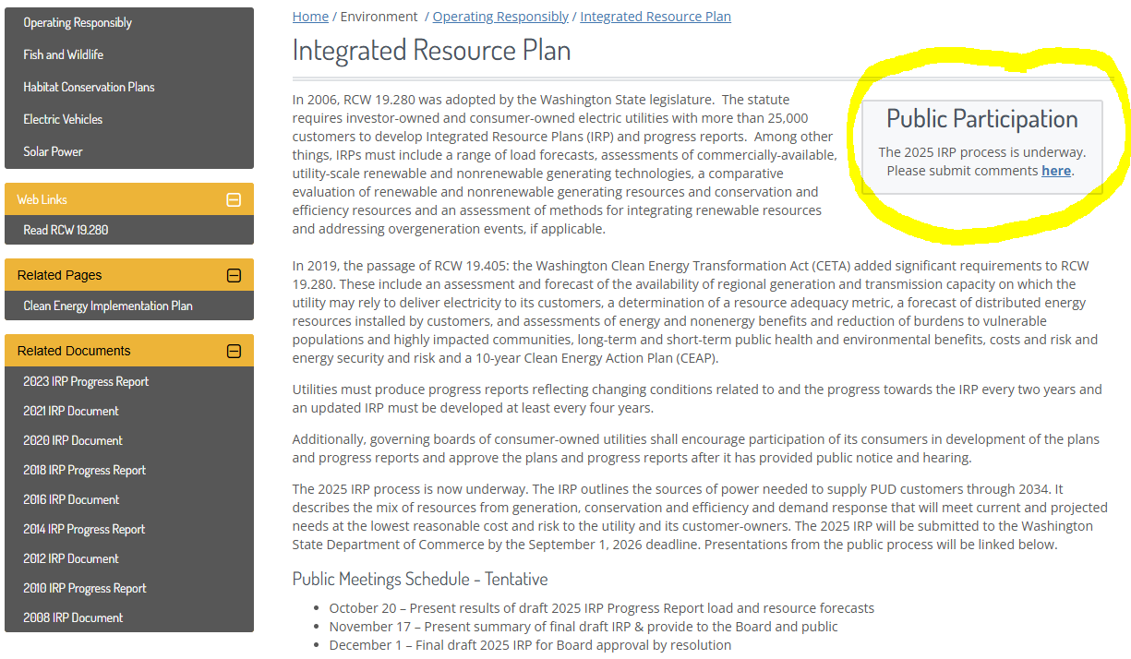
Chelan PUD IRP Website chelanpud.org/irp

Slide 12
Questions?

