Slide 1
Bavarian Substation
Feasibility Report - Findings & Recommendation
Board of Commission
Update
July 10, 2017

Slide 2
Today’s Agenda
Overview of Bavarian Substation Sites
Feasibility Report Findings
Recommendation – No action requested
Review next steps and timeline

Slide 3
Review
March 6th Board meeting
  Review initial engineering and costs comparisons for three sites: (CCPUD Site 9, City Site 8a, MEND Site 14)
  Stakeholder feedback and Leavenworth Focus Group supports Site 14, and Site 8a if Site 14 does not advance; Two sites moving forward
March 20th Board meeting
  Review power line easement rights
  Continuing discussions and learning with both City of Leavenworth officials and representatives from owner of Site 14 (MEND)
May 1st Board meeting
  Staff recommends purchase of Chumstick Site, located near Site 8a, due to recent availability and desirable site access attributes
  Board authorizes purchase of Chumstick Site and approved it as the preferred alternative
  Staff to proceed with consultant analysis of all three sites

Slide 4
Summary
Sixteen areas were initially identified and four sites were analyzed by Consultant Feasibility Evaluation
Consultant Feasibility Evaluation recommends the Chumstick Site as the preferred alternative, which is consistent with the Leavenworth Focus Group and Board endorsements of Chumstick Site
District staff recommends selection of the Chumstick site as the preferred alternative
Next steps would include proceeding with permit level design, initiating the Conditional Use Permit (CUP) process, and further evaluation of transmission routing

Slide 9
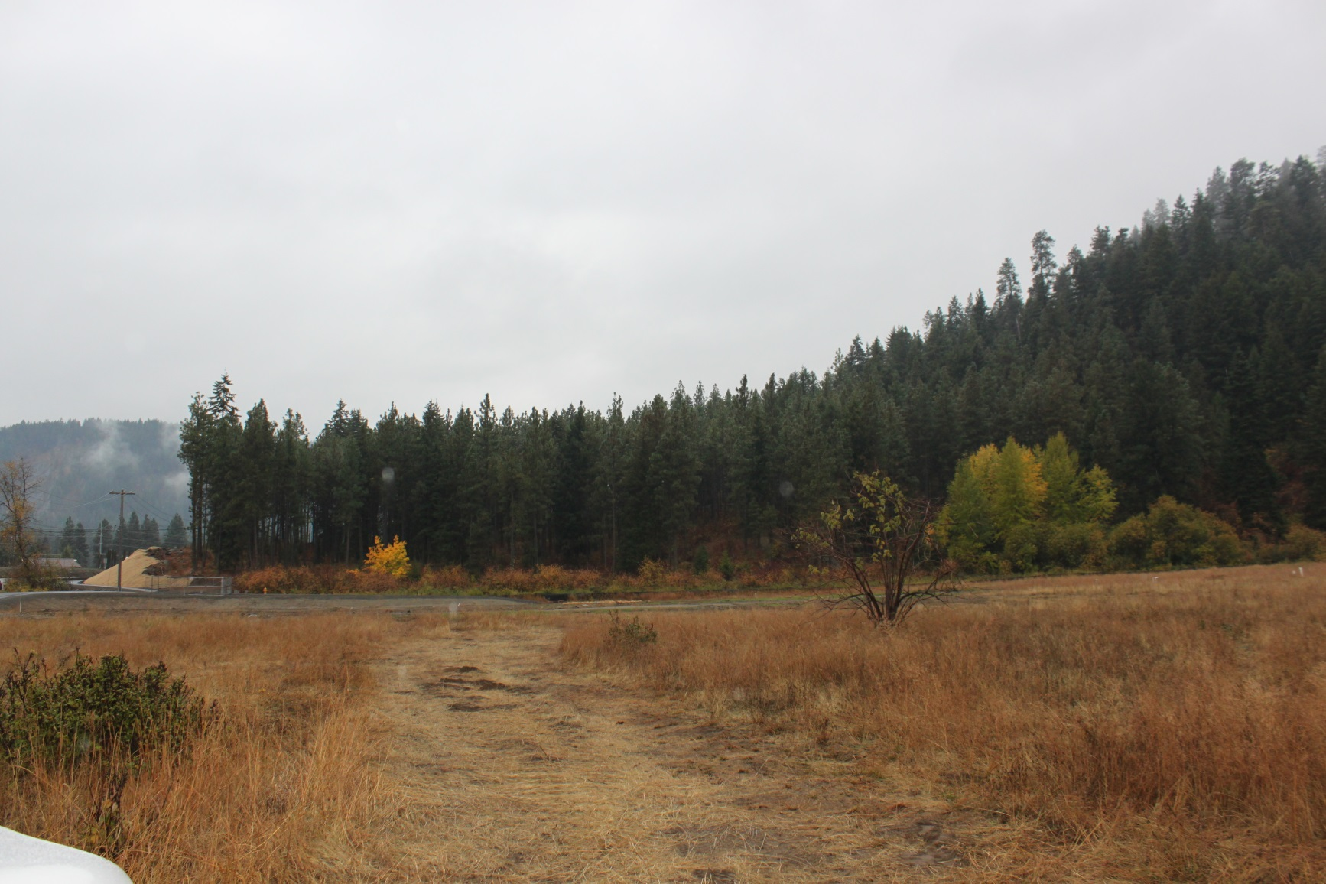
City Site 8a - Existing

Slide 10
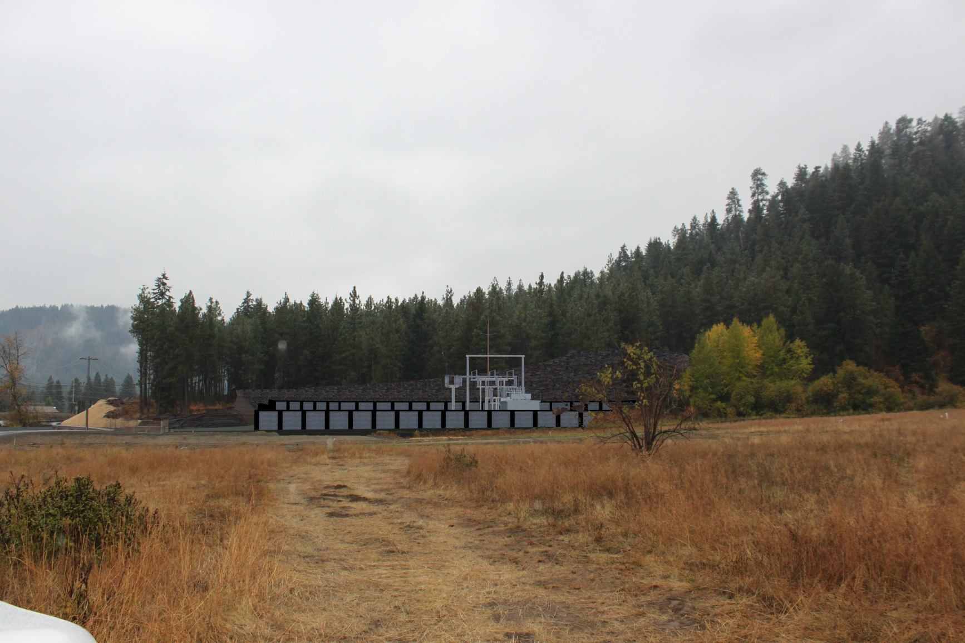
City Site 8a - Rendering

Slide 14
MEND Site 14 - Existing

Slide 15
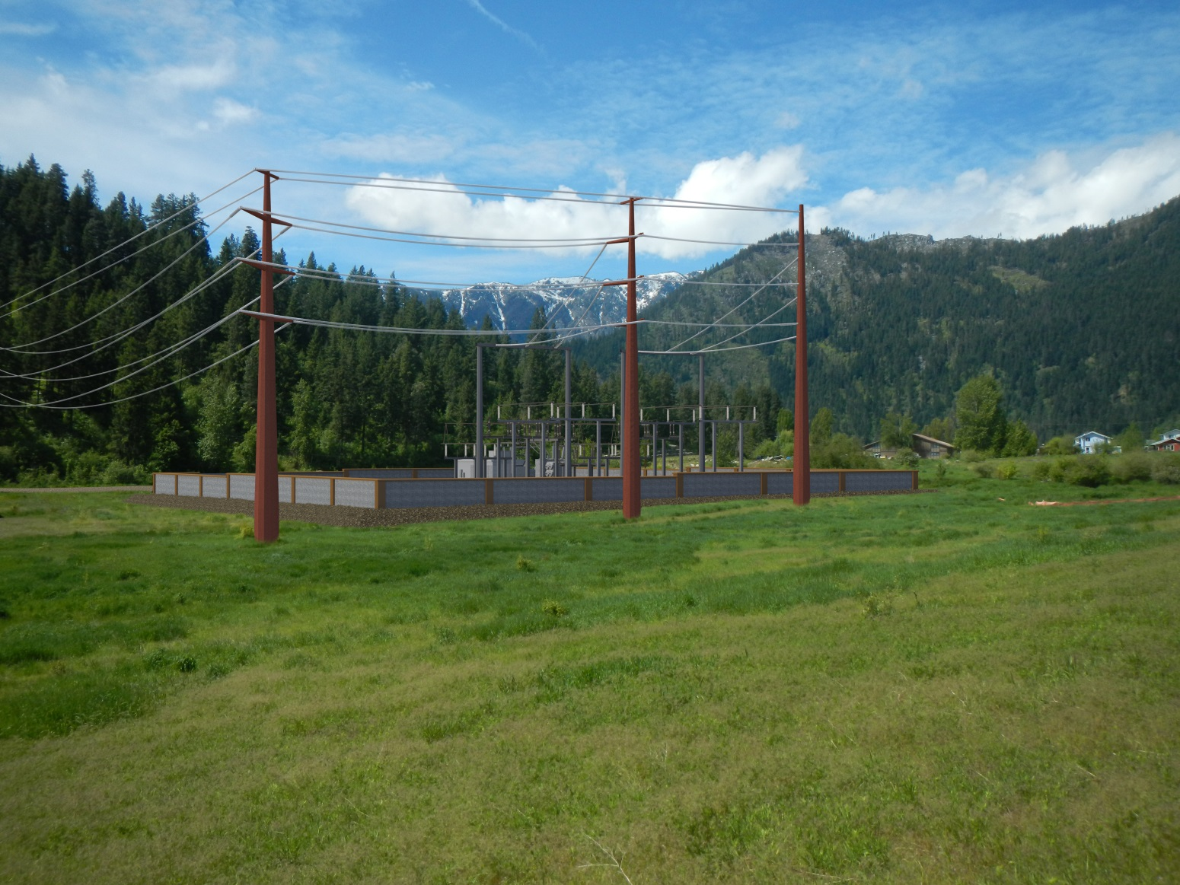
MEND Site 14 – Alt 1 Rendering

Slide 16
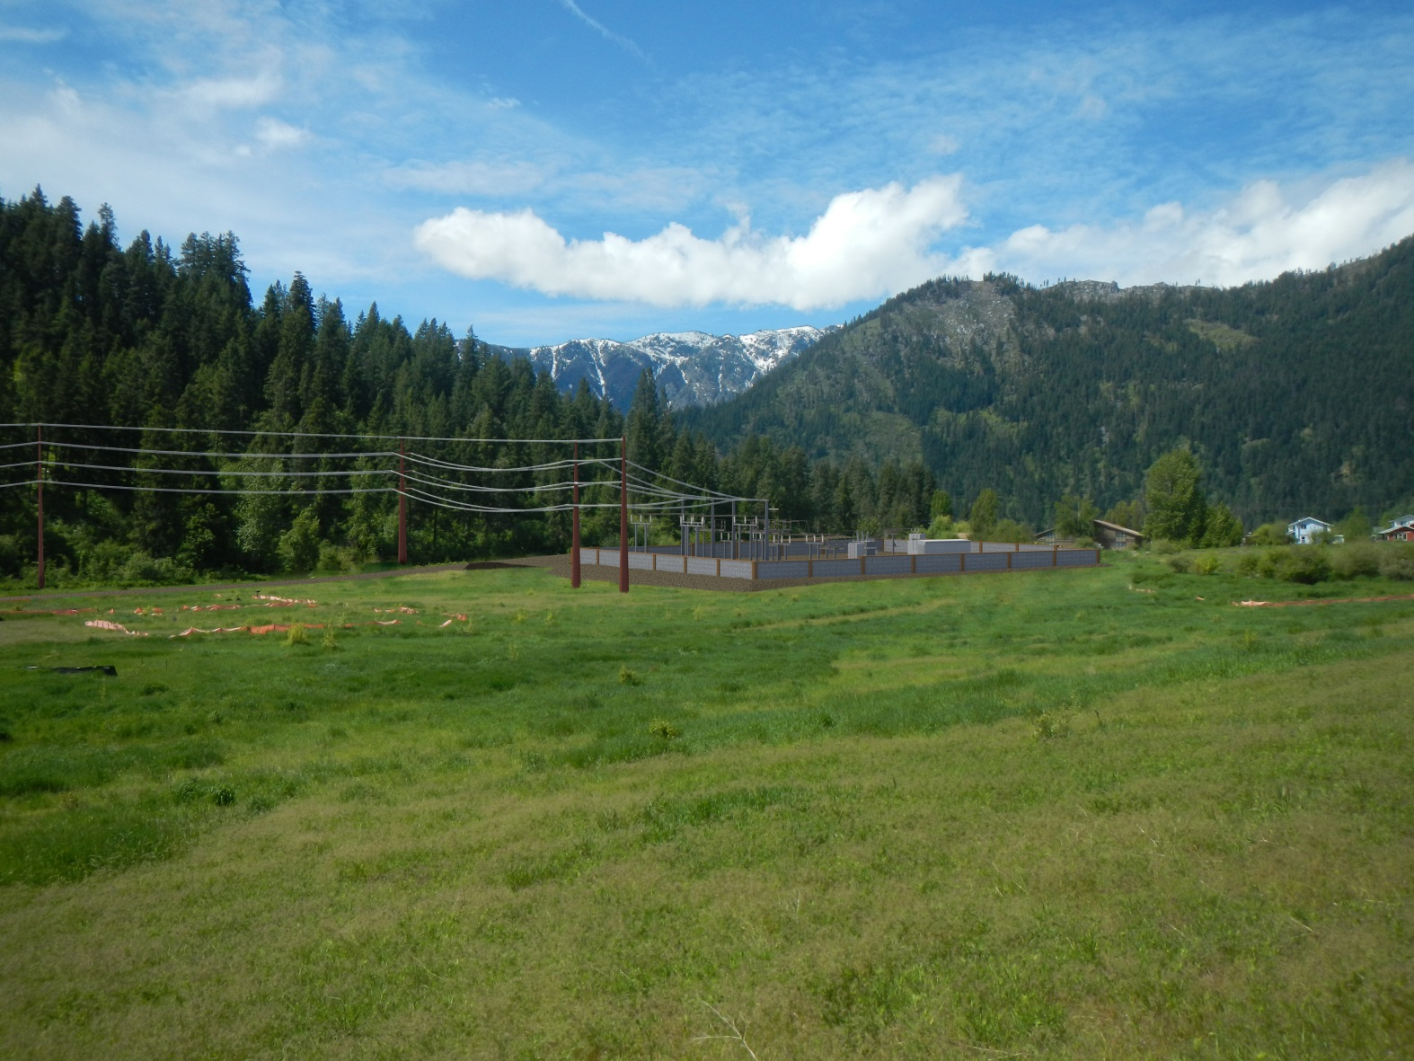
MEND Site 14 – Alt 2 Rendering

Slide 19
Chumstick Site - Existing

Slide 20
Chumstick Site - Rendering

Slide 21
Bavarian Substation
Planned Next Steps & Timeline
July 10: Invite focus group members to Commission meeting
July 11: Update Leavenworth City Council and community with Feasibility Report Findings & Recommendation
July: Initiate CUP Process
July: Initiate Permit Level Design
July – September: Evaluate Transmission Routing in combination with stakeholder outreach
Q3-Q4: Begin major equipment purchases

Slide 22
Questions?

