Slide 1
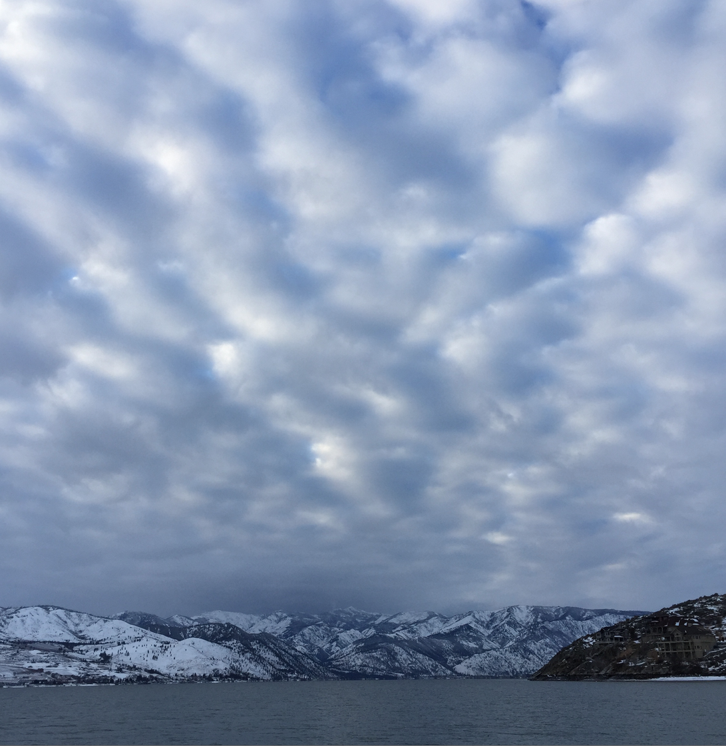
Lake Chelan Water Quality Update
Phil Long, Lake Chelan Research Institute
Mike Kaputa, Dept. of Natural Resources, Chelan County
March 28, 2017 Tri-Commission

Slide 2
Proposal
Partners should consider a financial contribution to support Lake Chelan water quality studies
$50,000 annual total cost
Develop long-term funding strategy
City of Chelan
Port of Chelan County
Cascadia Conservation Dist.
Chelan County
Chelan County PUD
Others
Lake Chelan Reclamation District
Lake Chelan Sewer District
Cascadia Conservation District
WA Department of Ecology

Slide 3
Why?
Preventative: Need to monitor water quality to know if something is going on
No surprises: EPA Finds Trout in Washington's Lake Chelan Have High Levels of Pesticide DDT (Seattle Times October 18, 2002)
Better science: More data versus limited data

Slide 4
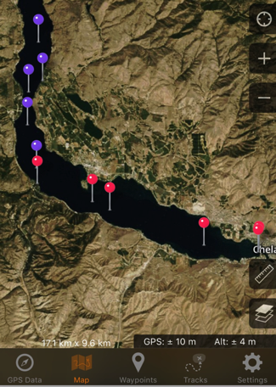
LC-8
LC-1
Notes:
Note that we don’t know if we have actually exceeded yet the TMDL for P. On average with 4 events we make still be OK. BUT the reality is that this is still a negative result since no previous measurements showed this pattern or were this high.

Slide 5
LC-8
LC-1
Notes:
Note that we don’t know if we have actually exceeded yet the TMDL for P. On average with 4 events we make still be OK. BUT the reality is that this is still a negative result since no previous measurements showed this pattern or were this high.

Slide 6
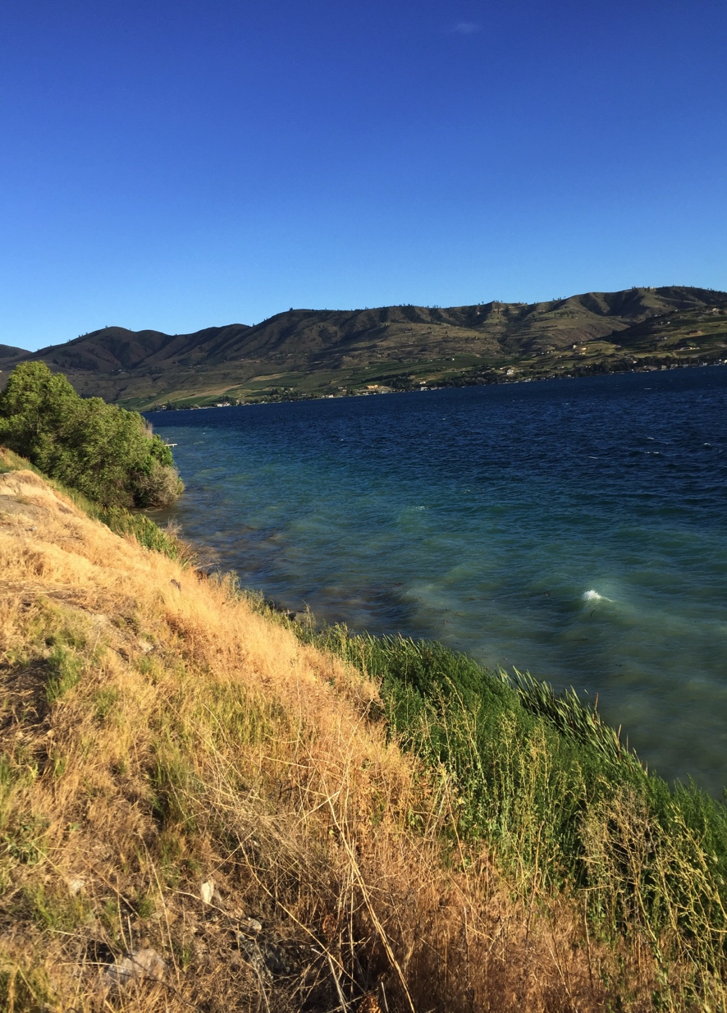
Possible Reasons for Increased Phosphorus
Increased shoreline erosion
Dust
Septic system failure
Avian fecal deposition
Increased rainfall or irrigation
Agricultural drains
Storm water collection system
Streams (e.g. Stink Creek, First Creek)
Delayed effect from the 2015 fires
Recycling from bottom sediments

Slide 7
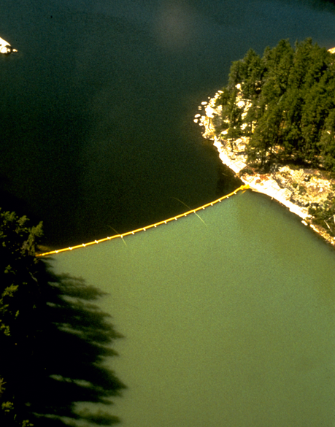
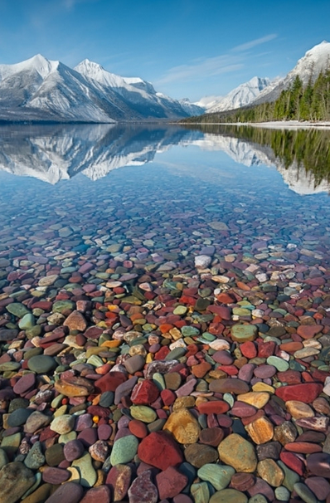
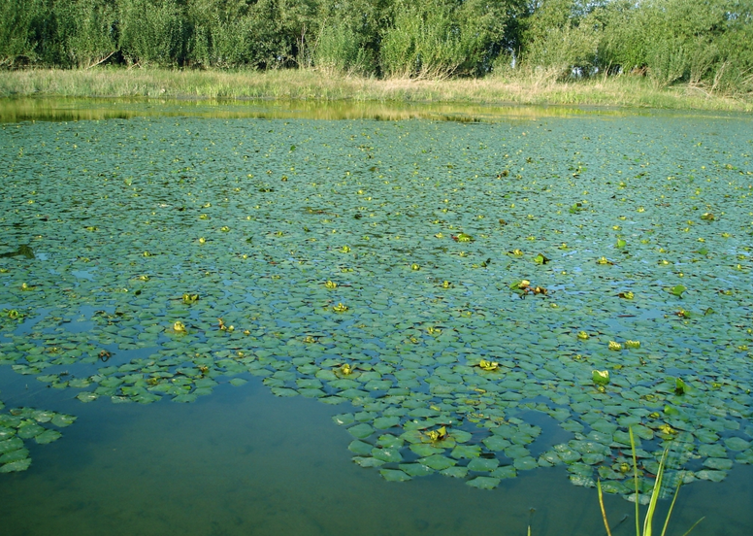
Trophic Status
Ultraoligotrophic
Oligotrophic
Mesotrophic
Eutrophic
Hypereutrophic
Increasing
C, N, P

Slide 8
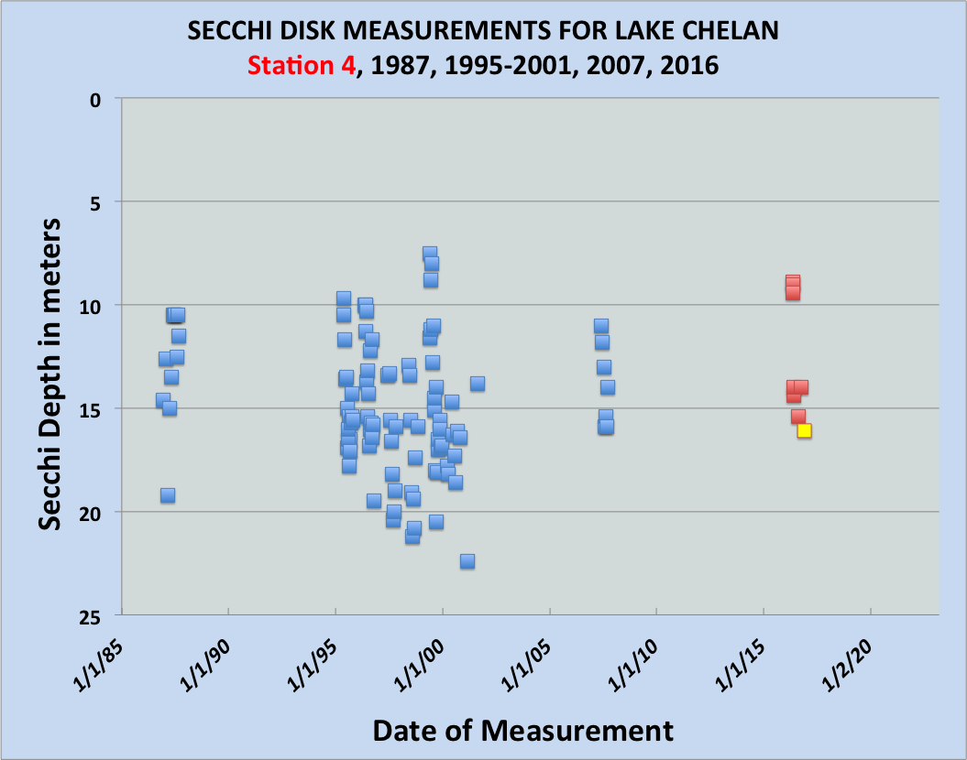
For comparison, Lake Tahoe has a 50-year record of Secchi disc data
8-year gap
6-year gap
9-year gap
First student data point!
Notes:
These are ALL known the Secchi disk measurements of water clarity AT SITE 4. Describe the location of Site 4 or could do a a slide with it (this currently the same as our site LC-5. The red and light green dots are the 2016 data. The plot shows that recent measurements are within the range of past observations. It also illustrates the long gaps in our Secchi disk data, a problem we intend resolve going forward. Note the Yellow square is student data collected Nov 30, 2016.

Slide 9
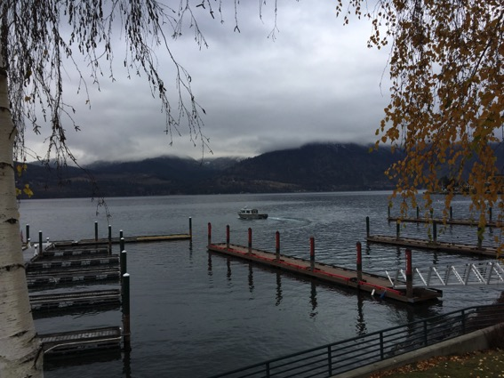
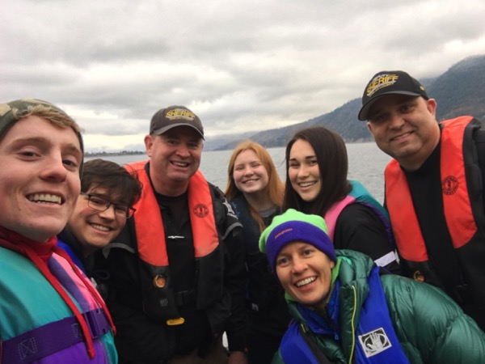
Chelan and Manson High School Students Collect Water Quality Data!
Nov 30th Sheriff’s Officers Duke and Moody took April Slagle’s Chelan HS and Erik Hellson’s Manson HS students out on Lake Chelan to collect Secchi disc and temperature data (a first!)
Special thanks to the Sheriff’s Department especially the Marine Patrol
See GoLakeChelan for an extensive article on this topic
Notes:
It great to get this actually started. Sheriff’s Department participation and enthusiasm is crucial! There are some kinks to work out, but we are now planning monthly outings

Slide 10
Funding Overview
Annual budget need is $50,000
Ongoing budget beyond 2017 also needed
Ecology:
Supposed to do follow-up monitoring but does not
Indicated interest in contributing

Slide 11
Lake Chelan Research Institute Board of Directors
Participants:
Phil Long (Interim LCRI Director and Board Chair)
Chuck Nittrouer (UW Oceanography)
Mark Wigmosta (PNNL and UW joint appointment)
Steve Nelson (RH2)
Clay Patmont (Anchor QEA)
Dennis Lettenmaier (UCLA, joining remotely)
Michael Brett (UW Civil and Environmental)
Rebecca Neumann (UW Civil and Environmental)
Stephanie Hampton (WSU, Director, Center for Environmental Research, Education and Outreach)*
Jack Stanford (Emeritus Director of the Flat Head Lake Biological Station, has agreed to join the board but is traveling so will not be able to participate in the meeting)*
Ex Officio Members:
Mike Kaputa (Chelan County Natural Resources)
Bonnie Ellis (Representing Flathead Lake Biological Station. pending Jim Elser’s input. Bonnie is traveling so will not be able to participate in the meeting)*
Note: Discussions with other proposed ex officio members is still in progress.
*Not available for the November 4th meeting
Notes:
Note what an incredibly strong group this is and especially note the value of having Jack Stanford and his wife Bonnie Ellis involved. They were not at the Nov 4th meeting but have agreed to participate and have retired from the Flathead Lake Biological Station, where they did an incredible job.

Slide 12
Chelan Chamber of Commerce
Assistance with development of “Keep Chelan Blue” window stickers for businesses:
Basic logo as a easily applied (or removed), clear window sticker:
Available to all business willing to display it
Link to their web page will be included on the “Keep Chelan Blue” web page
Business who financially support the Lake Chelan Research Institute will be designated as “silver”, “gold”, “platinum” or “diamond” depending on level of support
Designation will be identified by an additional sticker below the Keep Chelan Blue logo

