Slide 1
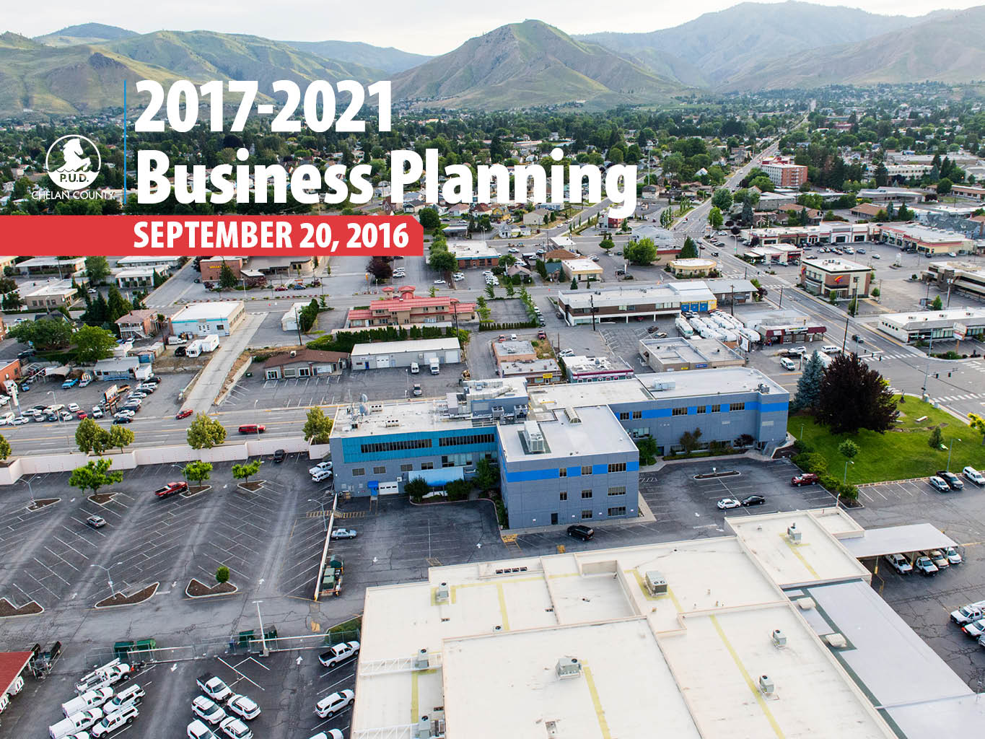
2017-2021 Business Planning
Working Draft – 9/14/17
September 20, 2016

Slide 2
What we will cover today…
Review Mission, Vision & Objectives
Key Drivers
Highlight 2017-21 Initiatives
Identify Known Unknowns
Operating Unit Plan Overview
No Board Action Required Today

Slide 3
What's different now compared to the Strategic Plan? (Aug 2016 vs. Dec 2014)
Description | 2017-2021 | to 2027
Bottom line | (70) | (307)
Net Wholesale Revenue | (46) | (294)
Operating Expenses | 35 | 27
Capital Expenditures | 17 | 11
Total Liquidity | (4) | (199)
Debt Outstanding | 75 | 128
Heavy load market prices (est.) | 30.99 v. 45.52 | 39.70 v. 63.29
Light load market prices (est.) | 24.65 v. 34.97 | 35.99 v. 52.19

Slide 4
Key Drivers
Declining wholesale market is having substantial impact on revenues after 5 year slice sales
Increasing capital and O&M costs primarily due to investment strategy and unplanned outages
Renewing use of borrowing in headlights (roughly 2022) consistent with long term debt philosophy with focus on managing liquidity
Very early rate management planning in case we encounter the worst case scenario
Foreseeing liquidity issues in the out-years, tightened up planning more closely reflect capital and O&M expected values making plans more likely to be achievable given our staffing - also means we will be more likely to have instances of exceeding our budgets.
Notes:
Declining wholesale market is having substantial impact after 5 year slice sales
Capital and O&M costs have increased primarily due to investment strategy and unplanned outages
We can see renewed use of borrowing in headlights (roughly 2021) due to development of long term debt philosophy with focus on managing liquidity
As we foresee liquidity issues in the out-years we have tightened up budgeting to make capital/O&M more consistent with expected value - makes our plans more likely to be achievable given our staffing - also means we will be more likely to have instances of exceeding our budgets.
Very early rate management planning in case we encounter the worst case scenario
FYI - 2015-19 Changes
- Achieving metrics leading to acknowledgment of improved long term financial circumstances
- Moving strategically from preservation mode to creating long term value while recognizing recent events have been financially difficult
- Recalibrated financial policies and set metrics for 2015-2019
- Putting cash to use for long term financial health
- Rocky Reach turbine repair better understood
- Substantial increase in work and costs over next 5 years
- Situational assessment of Rock Island
- Wanapum Dam Fracture
- Unanticipated event that created need for operational response causing a delay in planned work
- Regulatory Compliance
- Substantial increase in reliability standards implementation
- System Growth
- Increasing desires for customer/stakeholder engagement and resulting expectations
- Strategic planning is mid-stream
- Have not prejudged outcome of process
- Resources will be needed to implement strategic planning decisions

Slide 5
Key Drivers
As net revenues in out-years have declined, we have reconsidered our strategic priorities through discussions with Board members
These plans retain all priorities while prioritizing within
Reinvesting in assets and people - No change
Reducing debt - on track to achieve less than 35% debt ratio but reconsidering accelerated debt payments in 2018/19 if needed for liquidity
Retaining Public power benefit at current level - more likely to stay at "crawl" level proposing no new solicitation for 2018
Notes:
As net revenues in out-years have declined, we have reconsidered our strategic priorities through discussions with Board members
This budget retains all priorities while prioritizing
Reinvest in assets and people - No change
Debt reduction - On track to achieve less than 35% debt/equity ratio but reconsidering accelerated debt payments in 2018/19 if needed for liquidity
Public power benefit - Retains PPB at current level but more likely to stay at "crawl" level proposing no new solicitation for 2018

Slide 8
Notes:
Accelerated debt repayment to help prepare for low probability/high consequence negative financial events
Moving toward debt target of <35% by 2019 (Rates)
Achieving the recalibrated financial metrics (Rates)
Catching up on deferred maintenance and capital projects
Wanapum/RR/Preservation Mode have all led to a need for infrastructure investment activities (Rates & Reliability)
Developing capability to increase our probability of successfully accomplishing a higher percentage of our planned capital and O&M (Rates & Reliability)
Seeking out long term value
Building on our success in increasing revenue by investing in marketing opportunities that can produce net revenue (e.g. EIM, carbon pricing) (Rates)*
Analyzing/engaging market restructuring that impacts wholesale hydro revenues (Rates)
Engage Columbia River Treaty discussions seeking value for CCPUD customer-owners (Rates)
Smart meter/Outage management system business case analysis (Rates, Reliability, Customer Engagement)
Mid-C coordination issues (Rates)
Regulatory compliance investments - reliability (Reliability) and environmental, financial and market monitoring (Reliability, Environmental Stewardship, Operational Excellence)

Slide 9
To provide sustainable, reliable utility services that enhance the quality of life in Chelan County
Commit to the highest level of customer-owner satisfaction
CUSTOMER-OWNER
Protect natural resources impacted by operations
Ensure financial stability
FINANCIAL
Make continuous improvement in efficient, effective, compliant and risk-assessed operations
Invest in creating long-term value
INTERNAL
ENABLERS
Enhance the capability of Chelan PUD staff
Make our values the focus of relationships with customers, stakeholders & each other
Our Values: Safety, Stewardship, Trustworthiness and Operational Excellence
Notes:
Revised BSc based on the 7 Objectives from Strategic Planning
2015-19 Objectives (10)
Customer-Owner satisfaction
Provide valued public utility services
Protect and enhance our natural resources
Ensure financial stability
Manage costs with financial, environmental & customer responsibilities in mind
Implement governance, risk & compliance programs
Continuous improvement in efficient/effective management
Invest in employees & uphold our values
Manage assets in a sustainable way
Value customers, employees, & stakeholder relationships
9

Slide 10
2017-2021 District Initiatives
Reinvest in core assets and people
Complete Rocky Reach large unit repairs
Initiate Rock Island modernization
Protect transmission lines against fire/weather
Implement asset management discipline
Develop regional water supply strategy seeking regional operating efficiencies
Complete cost-effective wastewater compliance improvements
Implement new Mid-C Coordination system
Implement long-term planning strategies for facilities

Slide 11
2017-2021 District Initiatives
Reinvest in core assets and people
Upgrade Customer Information System
Develop employees in the pursuit of safety and operational excellence for high reliability operations
Prepare for the future through employee skill development and succession planning
Update telecommunications systems
Advance two-way metering capabilities
Evolve Business Intelligence (BI) capabilities
Expand energy efficiency programs

Slide 12
2017-2021 District Initiatives
Pay down debt
Achieve debt ratio of less than 35% one year ahead of 2019 target
Public Power Benefit Program
Continue Fiber system expansion
Complete feasibility studies
Continue program for park passes
Debt reduction plans continue

Slide 13
Known Unknowns
Changes in electric market fundamentals/pricing
Results of asset condition assessments
Cyber security risks
Pace of new and changing regulatory requirements
Impacts of new large loads and distributed generation
Magnitude of additional costs for facilities master plan
Hydro licensing reform legislation impacts
Risks of having one dominant fiber retail service provider
Ability to attract and retain qualified employees
Climate change impacts
Frequency of natural disasters such as fires and storms
Stakeholder engagement expectations lengthen timelines and resource requirements
And more…
Notes:
Changing electric market fundamentals
Natural gas prices, Variable Energy Resource market penetration, structure support for hydro/flexible capacity ,GHG emission pricing
State of assets - Condition assessments for RI/RR, increase redundancy
Regulatory Compliance - Reliability, environmental, financial, market structures, employment, etc.
Long-term facilities master plan – preliminary indications are that we may be under-spending on facility maintenance and improvements – additional investments beyond current spending are unknown and not included in this plan
Meeting stakeholder engagement expectations lengthen timelines and resource requirements to complete needed utility infrastructure improvements in a new era of dynamic changes
2015-19 Plan Known/Unknowns
- Wanapum dam interim pool raise
- Strategic planning outcomes
- Market prices, Streamflow and Outage Risks
- Natural gas prices
- Variable Energy Resource market penetration
- Market structure support for hydro/flexible capacity
- GHG emission pricing
- State of assets
- Regulatory Compliance
- Reliability, environmental, financial, market structures, etc.
- Condition assessment for RI/RR
- Weather/Fire

Slide 14
2017-2021 Plans Reflect our Prudent Financial Policies
Rate of Return 7.6% - 3.5% Target
2017-19 >4% 2020-21 >2%
Combined Cover
2.7 - 3.1
Target > 2.0
Liquidity above $220M Target > $175 M
Debt Ratio under 33% in 2018 Target
<35% by 2019
Notes:
Ultimate Debt Ratio target of < 35% by 2019

Slide 15
Expected Scenario
Minimum Liquidity Reserve Target
Notes:
Expected forecasts:
50% NWR expectation for periods 2015-2020, deterministic modeling assumption for NWR for periods 2021-2027
What if (low revenue) forecasts
Low E3 price scenario as of August 2015. 1 in 10 water year and 5% increase in O&M and Capital for each forecast year.

Slide 16
Expected Scenario
"What if" Scenario: Debt financed
Rock Island Powerhouse 2 rehabilitation
(expected and low revenue scenarios)
Minimum Liquidity Reserve Target
Low Revenue Scenario
Notes:
Summary talking points for comparison :
Reduced market expectations have decreased liquidity in the outer years (primarily 2020 & beyond)
Additional hedging activity (2015-20) has improved the “low revenue” scenario
Shifting the RI-PH2 Rehab up a few years has impacted liquidity (budgeted spending now starts in 2018 rather than 2021, “what-if debt financed” option shown starting in 2021)
Revised Capital spend expectations by applying the capital factor (90%- 2016; 80%-2017-2020) has improved the current “expected” & “low revenue” scenarios to 2020
Timing of some shorter term debt reduction schedules have changed slightly, improving short term expected scenario
Overall – “expected” scenario has declined in the outer years (2020 & beyond), but corresponding “low-revenue” scenario has generally improved in all years (the volatility has narrowed)
Expected forecasts:
50% NWR expectation for periods 2015-2020, deterministic modeling assumption for NWR for periods 2021-2027
What if (low revenue) forecasts
Low E3 price scenario as of August 2015. 1 in 10 water year and 5% increase in O&M and Capital for each forecast year.

Slide 17
Low Revenue Scenario
Notes:
Update prepared by Craig Kunz – 9/8/16:
Liquidity Comparison: As of Strategic Plan vs. 8/31/2016
Liquidity Variance
2021 2027
Liquidity Balance 2021 per 12/31/2014 Forecast $225M $356M
Liquidity Balance 2021 per 8/31/2016 Forecast $221M $155M
Delta -$ 4M -$201M
NWR -$42M -$291M
Service Revenue + $5M + $ 46M
Hydro Revenue: Production Sales +$14M + $ 22M
Hydro Revenue: Contract Additions +$5M + $ 14M
Hydro Revenue: Douglas and Other +$2M + $ 2M
Other Revenue -$6M - $ 4M
-$22M -$211M
Other O&M -$56M - $ 70M
Taxes - $ 3M - $ 8M
Depreciation (non-cash no impact) - -
-$81M -$289M
Interest Expense + $5M - $ 24M
Interest Earnings - $2M -$ 14M
Other Expenses - $9M -$ 22M
CIAC + $6M +$ 4M
Income Statement Impacts -$81M -$345M
Capital Expenditures +$ 2M +$ 9M
Change in Debt (accelerations or new deb) +$73M +$127M
Expected Change in Liquidity -$ 6M -$209M
Actual Change in Liquidity -$ 4M -$201M
*Difference $ 2M $ 8M
*Difference appears reasonable

Slide 18
Overview of Operating Unit Plans
Generation and Transmission
Customer Utilities
Fiber and Telecommunications
Energy Resources
District Services
Human Resources and Safety
Finance, Risk and Information Technology
Legal and Compliance

Slide 19
Summary
Strategic plan is working:
Achieving our 2017-2021 financial targets
Utilizing reserves to execute strategic goals to provide best value for customer-owners
Challenging to increase asset investments while wholesale revenues are forecasted to decline
Advancing prudent planning and decision-making
Next steps
Board feedback on draft plans through Sept.
Finalize business plans as of Sept. 30
Planning cycles to the 2017 Budget in Oct.
Notes:
Key takeaways:
2015-19 Strategic Plan integrated into business plans
reducing debt
investing in assets and people
initiating Public Power Benefit program
Plans achieve our financial targets
Addressing emerging challenges
Declining wholesale electric prices
Hydro projects
Safety

