Slide 1
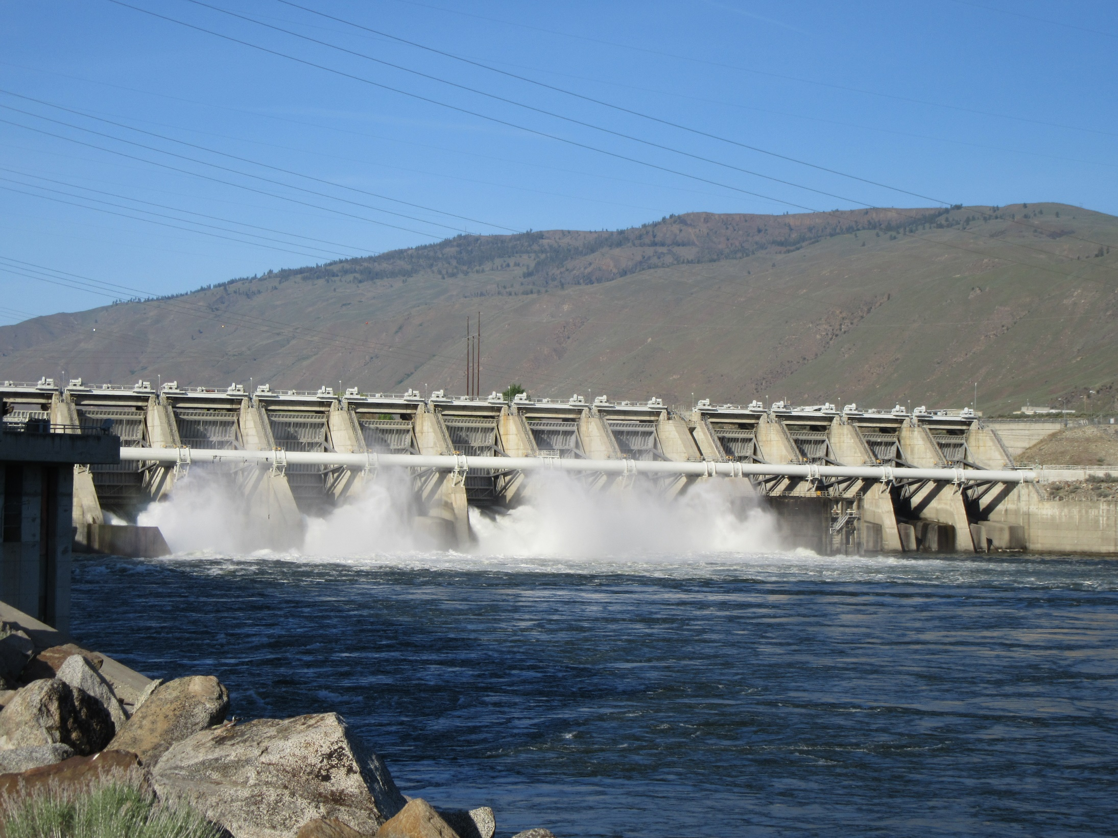


Long Range Facilities Plan
Findings, Summary and Next Steps
March 28, 2017

Slide 2
What have we Learned?
“Shaping our utility to do the best, for the most, for the longest”
Major Findings
  The District has been substantially underfunding facilities for many years.
  The District has not previously planned for facilities using a master plan or strategic approach.
  The District has not previously adopted standards for its facilities and now lags considerably behind the industry.
  Under the current approach, the costs of managing and operating the District’s facilities is increasingly expensive and unpredictable.
  The District’s current facilities are increasingly challenged with safety concerns.
  It will take a large initial capital investment to leverage long term financial value and meet the District’s Core Goals.

Slide 3
“Shaping our utility to do the best, for the most, for the longest”
Grand Summary
Downtown / HQ Facilities
Option 3 - 50 Year Plan
Scope: All new, consolidated Operations, Administration, and Customer Service facilities at new, north property. Sell existing PUD properties.
  Lowest Present Value:
  $8.9 million lower than Option 1 (status quo) and $4.6 million lower than Option 2 (split facilities).
  Evaluation Ranking:
  Ranks highest of all HQ options in qualitative evaluation, and best achieves District’s Core Goals.
  Present Value: $107.4 Million
  Initial Capital: $114 Million
Rock Island Facilities
Option 3a – 25 Year Plan
Scope: New and remodeled facilities for highest priority needs and greatest productivity gains, preserving options for future phases.
  Lowest Present Value: $2.2 million lower than Option 2
  Evaluation Ranking: Ranks highest of all scenarios in qualitative evaluation, and best achieves District’s Core Goals.
  Present Value: $33.5 Million
  Initial Capital: $36.2 Million
Rocky Reach Facilities
Option 3a – 25 Year Plan
Scope: New and remodeled facilities for highest priority needs and greatest productivity gains, preserving options for future phases.
  Even Present Value: Approximately $100K higher than Option 2, the result of implementation time (10 yrs vs 3yrs) with limited productivity.
  Evaluation Ranking Ranks highest of all scenarios in qualitative evaluation, and best achieves District’s Core Goals.
  Present Value: $34 Million
  Initial Capital: $32.6 Million

Slide 4
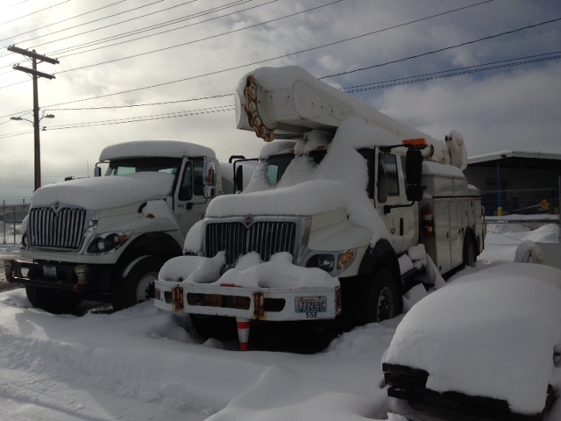
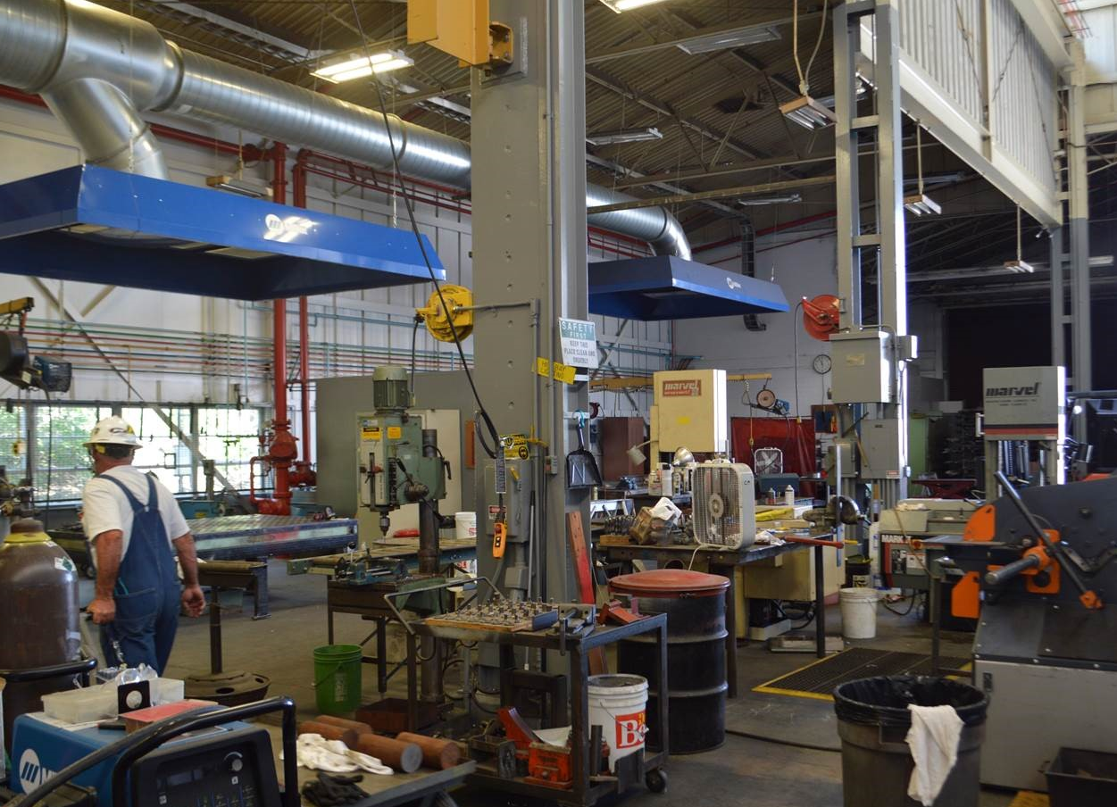
“Shaping our utility to do the best, for the most, for the longest”
Key Benefits
Key Benefits of Recommended Options
  Location of crews, equipment and materials will provide better average outage response time for customers
  Initial investment provides the lowest long-term cost
  Enhanced customer experience when:
    Requesting new services
    Paying bills
    Applying for permits
    Attending public meetings
    Accessing conservation resources
  Higher employee productivity and lower travel cost
  Best opportunity for increased safety and code compliance
  Best option for long-term cost predictability
  Contributes to recruiting and retaining highly qualified workforce

Slide 5
Combined
Financial Analysis
“Shaping our utility to do the best, for the most, for the longest”
Cumulative Cash Flow (HQ 50 yr / Hydros 25 yr)
(Combined Capital Investment, M&O, Salary/Productivity)

Slide 6
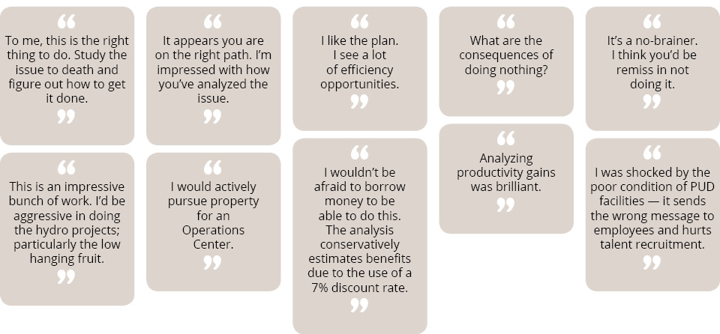
Comments From February 27, 2017 Meeting
Customer Advisory Committee

Slide 7
“Shaping our utility to do the best, for the most, for the longest”
Next Steps
Outreach Plan
Employee Outreach
  Update for employees involved in SFP Development: March 15-17
  All employee e-mail update: March 20
  Online information: Week of March 20
County-Wide Outreach
  Tri-Commission March 28
  Port Commission April 4
  On-Line Resources/Video
  Open House Events (Wenatchee, Leavenworth, Chelan)
Implementation Planning
Create a Detailed Implementation and Spending Plan
  Determine method of project delivery
  Develop project team structure and key roles
  Evaluate resources necessary for planning and execution
  Develop implementation sequencing schedule
  Develop financing strategy
Complete Strategic Plan
Plan Finalization
Prepare final Strategic Plan document with recommended scopes, schedules, and budgets for priority projects.
  Complete detailed programming & pre-schematic work
  Refine conceptual design for all sites
  Establish general standards & sustainability goals
  Incorporate Implementation and Spending Plan

Slide 8
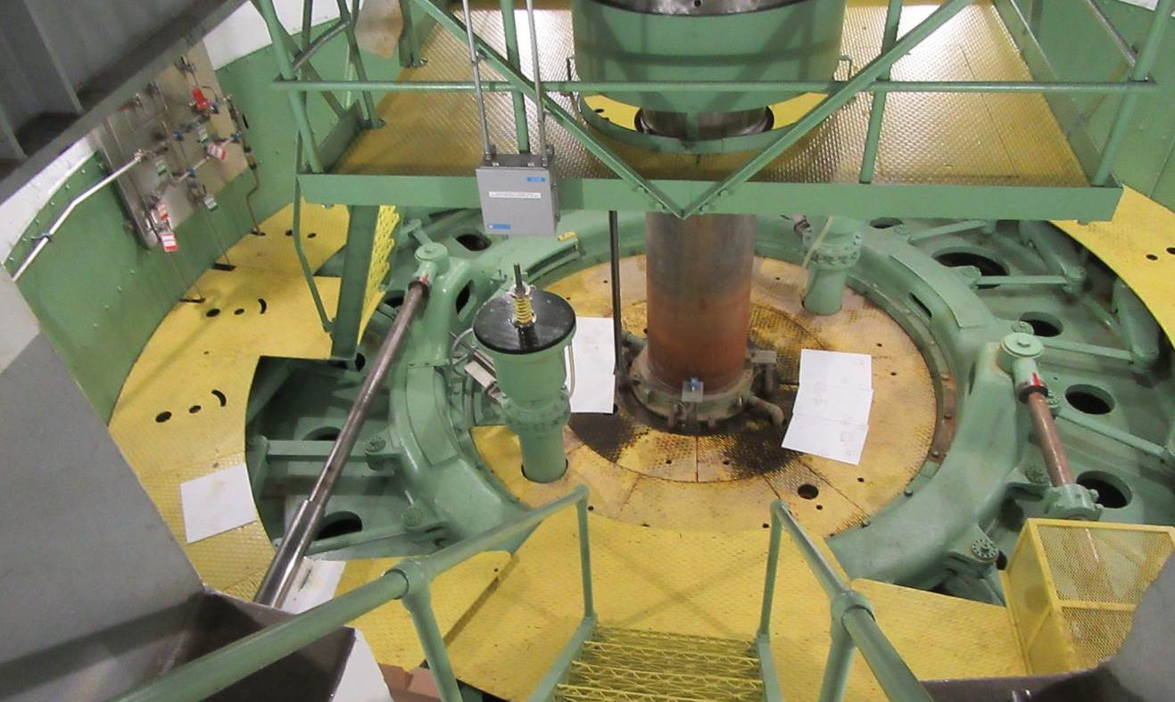
4 Questions

