Slide 1
Proposed City of Wenatchee Comp Plan Update: Impact on Olds Station
Business Park
Tri Commission Meeting
March 29, 2017

Slide 2
Proposed Comprehensive Plan Update
2016 City annexation of Olds Station
2017 proposed Comprehensive Plan Update modifies land use
Expands North Wenatchee Business District zone to include Port buildings and land
Changes Horan Block from Industrial to Waterfront Mixed Use, allows multi-family residential
Prohibits Industrial, makes Light Industrial a conditional use

Slide 3
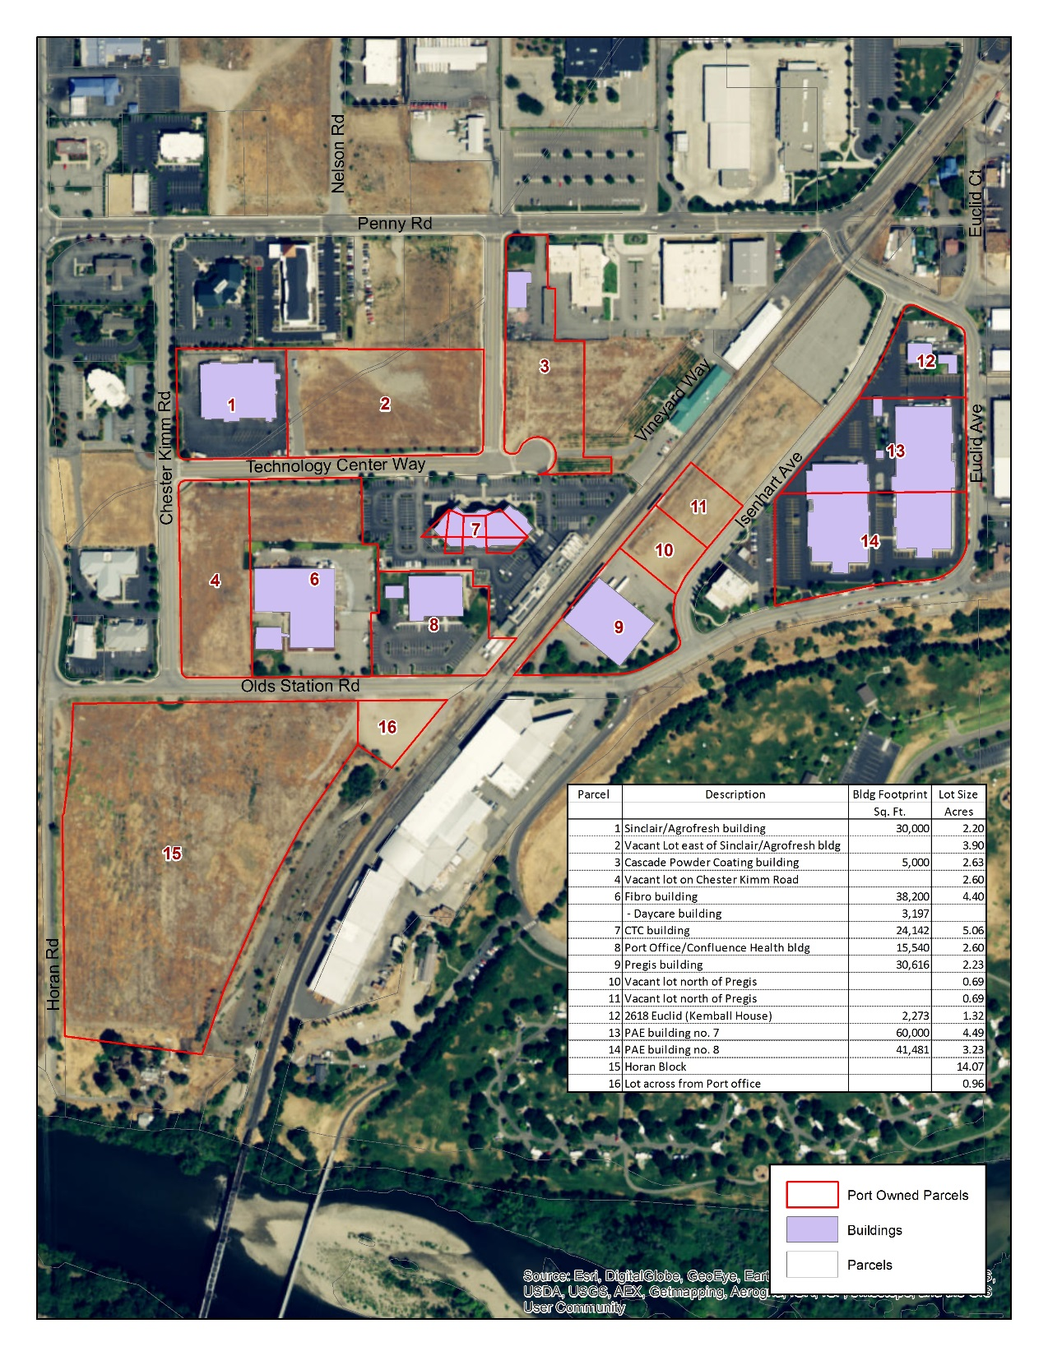

Slide 4
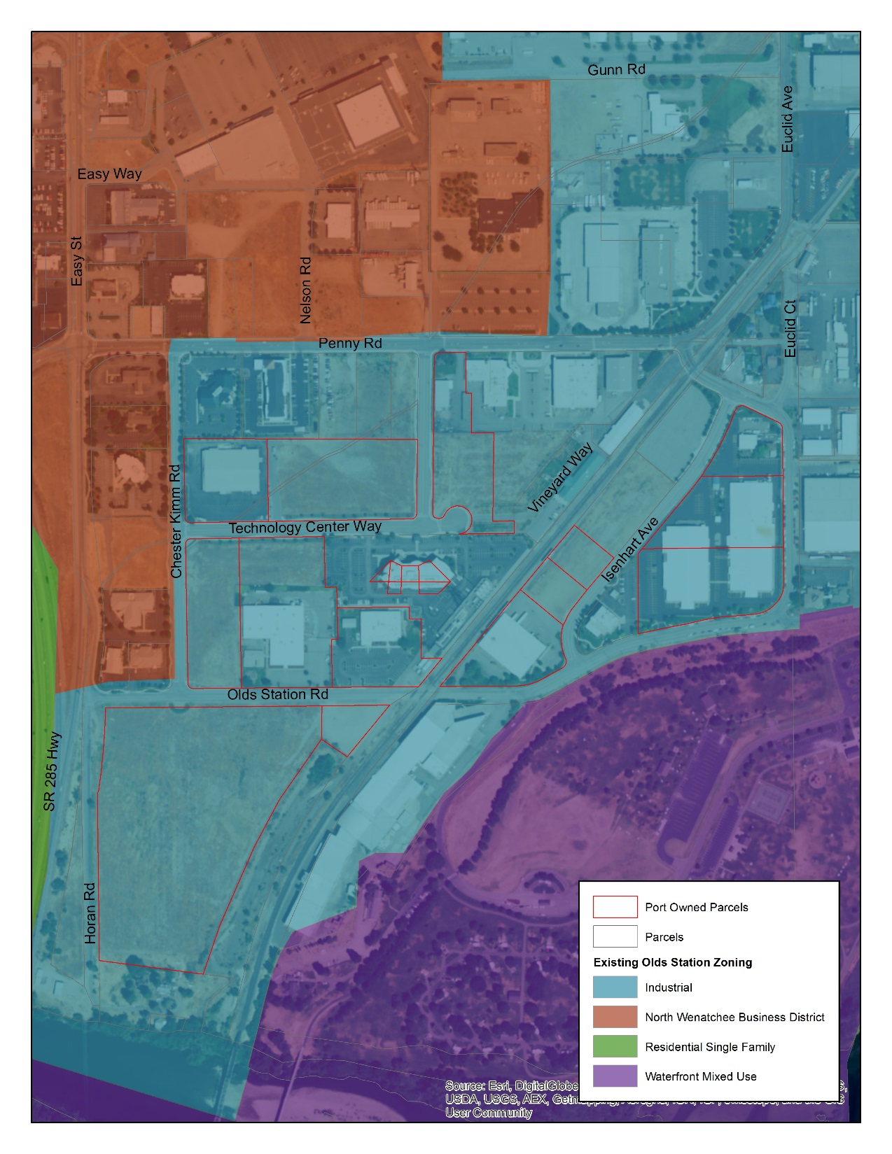

Slide 6
Brief Land Use History
1981 – Planned Development approved, delegated authority to Port to oversee development
Port invested in the extension of sewer into Olds Station, road construction and improvements, regional stormwater retention facilities
County approved building permits and uses based on 1981 PD
Covenants on properties adopted and since updated; essentially prohibit residential use
Multiple properties along Easy and Penny streets have been declared surplus and sold

Slide 7
Port has communicated with City
Met with Mayor and staff
Appeared before Planning Commission
Submitted comments to City Council, Planning Commission and staff
Requested current land use be left in place

